Slide 1

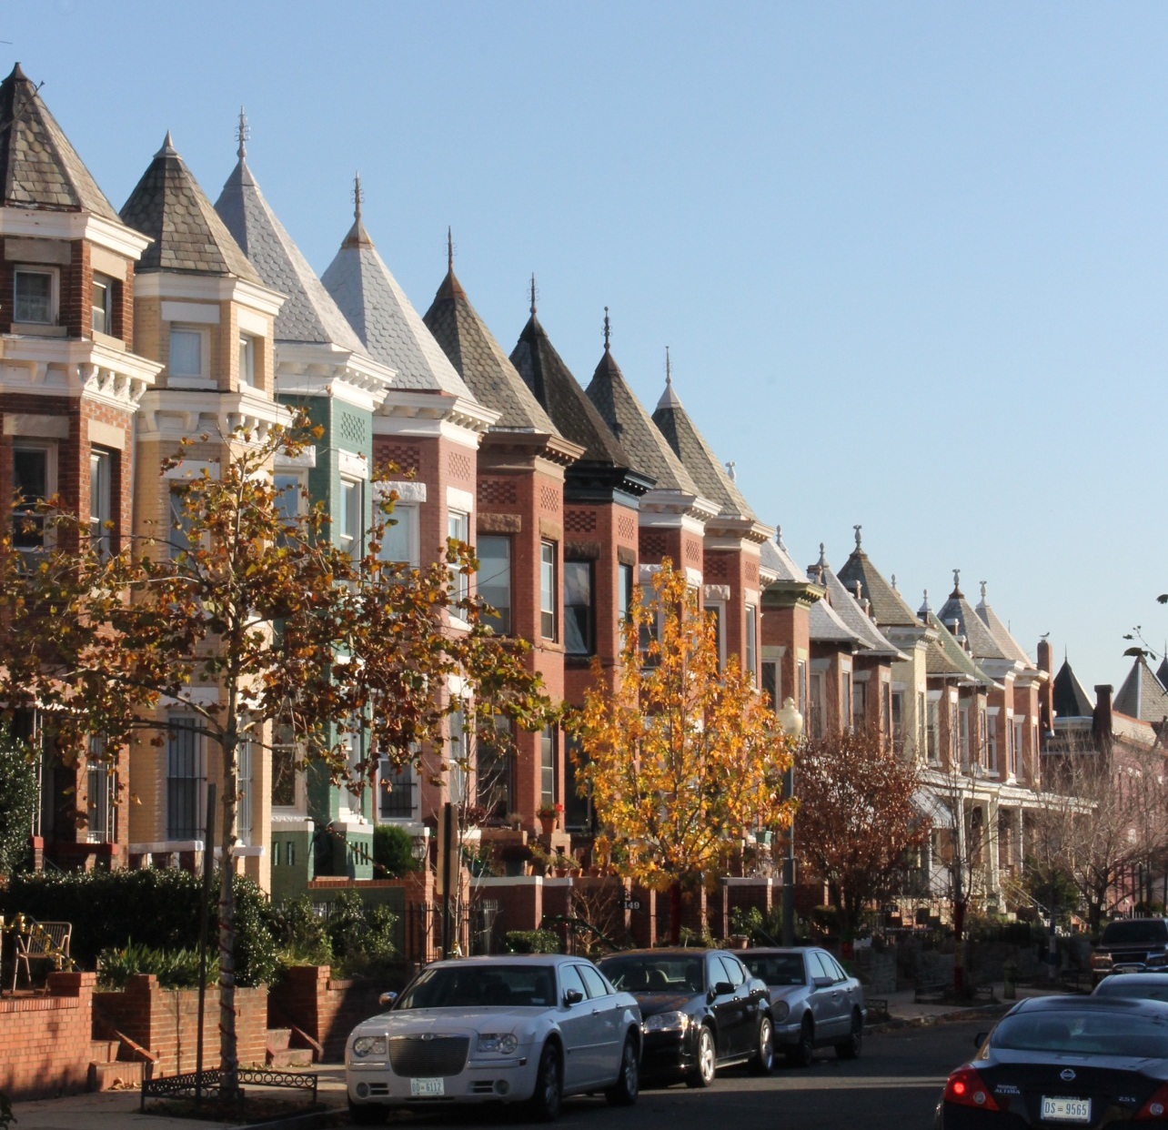
Historic Preservation in Washington, DC

Slide 2
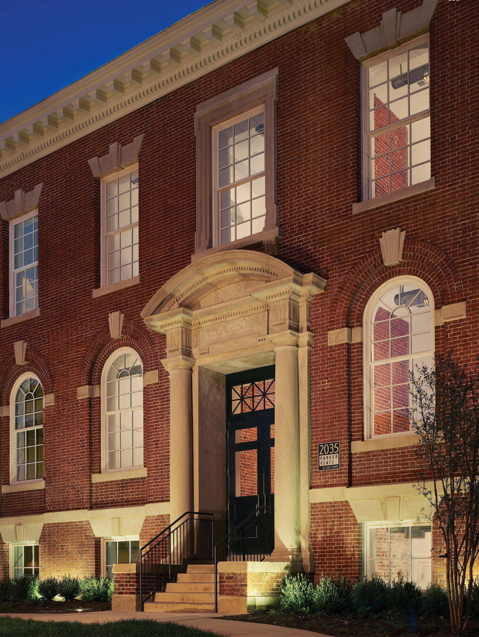
Purposes of the D.C. Historic Preservation Law
Protect, enhance and perpetuate the distinctive elements of the city’s social, cultural, economic, political and architectural past;
Promote the use of historic landmarks and districts for the pleasure and welfare of the city’s residents and tourists;
Safeguard the city’s heritage

Slide 3
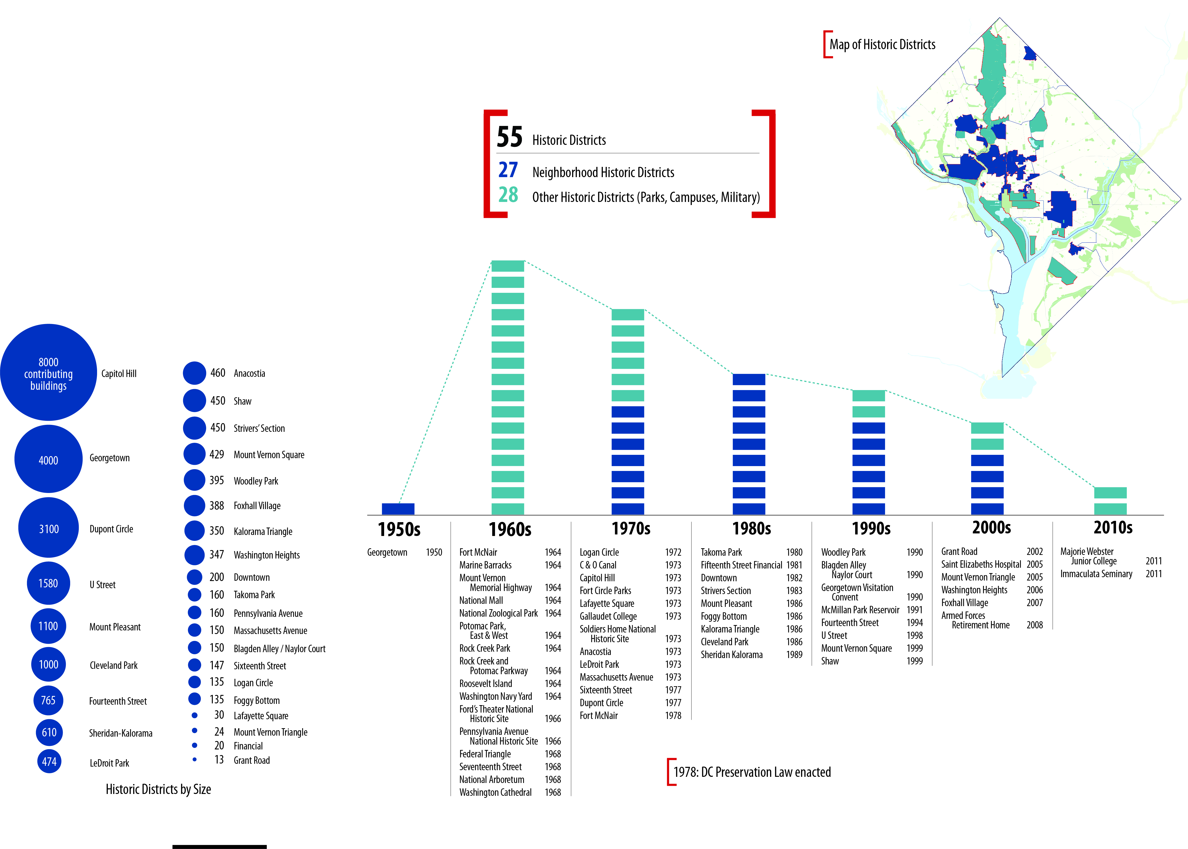
DC Historic Districts

Slide 4
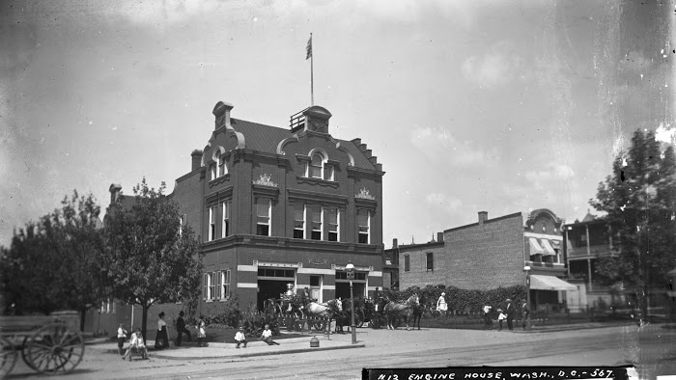
Why Designate?
Educates residents and visitors about the history of a place;
Contributes to and/or reclaims a sense of community identity;
Fosters civic pride

Slide 5
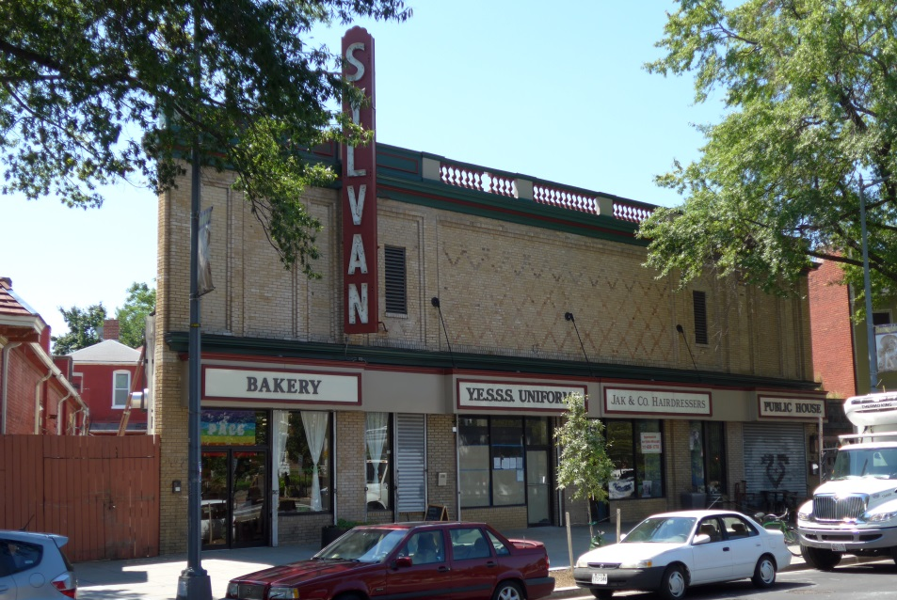
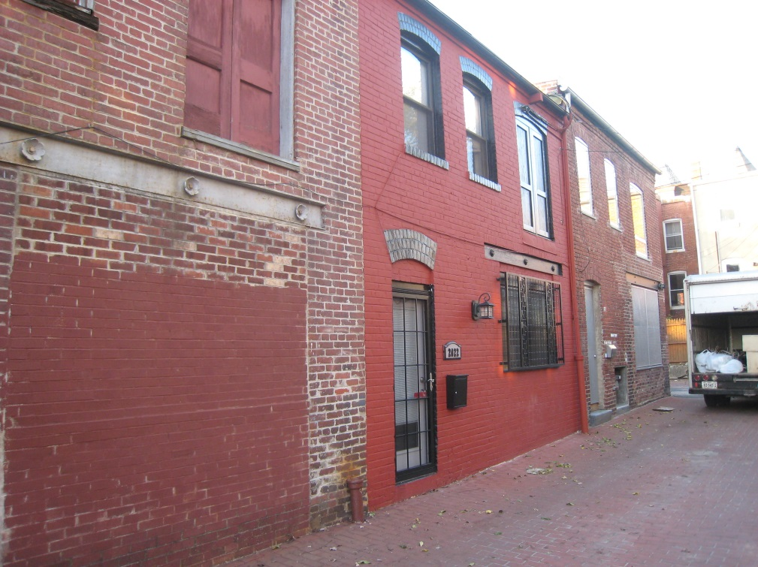
Benefits of Designation
Saves and restores important buildings
Recycles old buildings for new uses
Maintains community character and sense of place

Slide 6
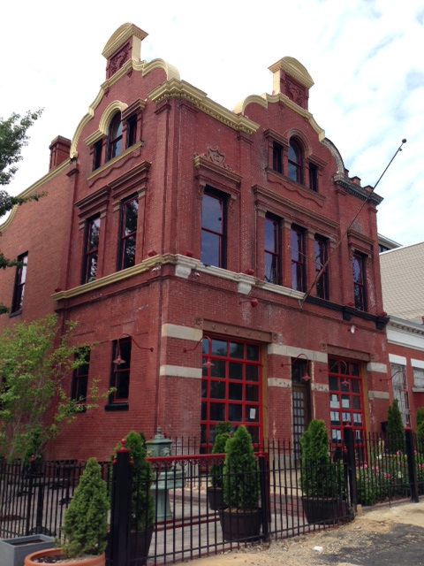
Benefits of Designation
Promotes rehabilitation and restoration
Provides tax incentives such as rehabilitation tax credits and conservation easements and may allow for homeowner grant funds
Allows for community involvement in managing change

Slide 7
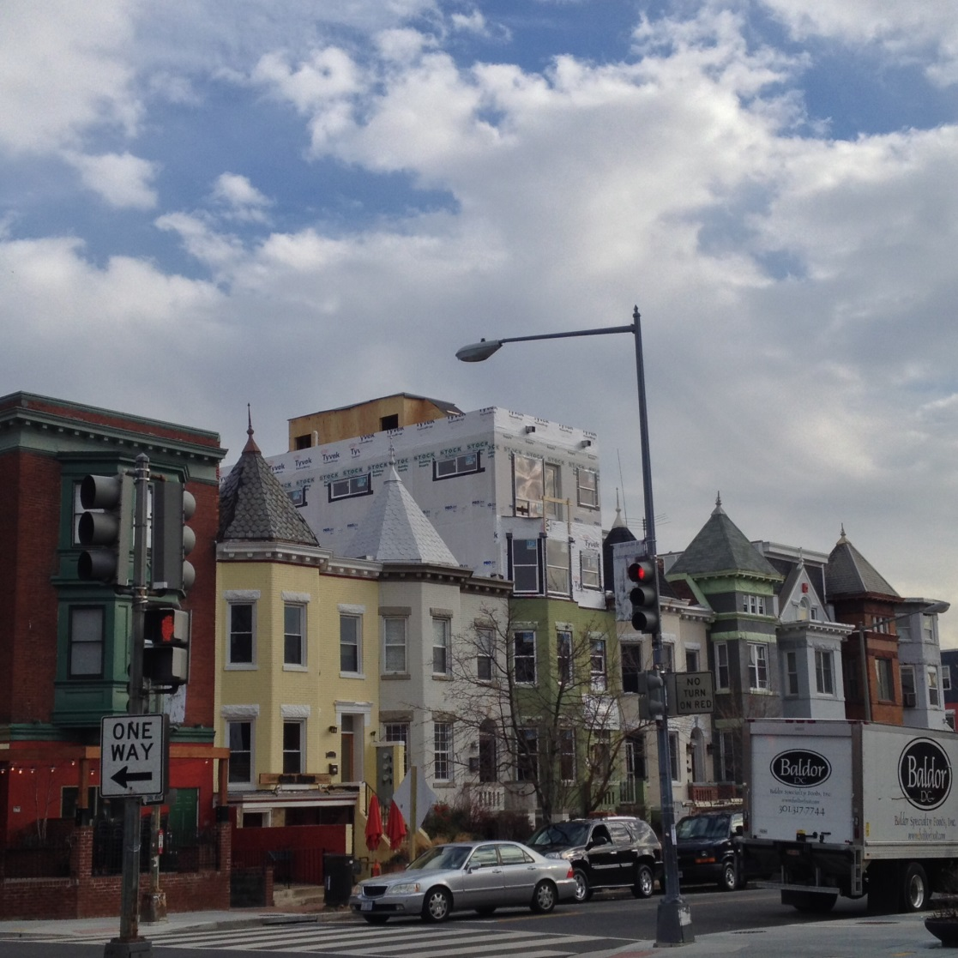
Why Historic Preservation Review?
Helps to ensure compatibility with the historic character of the property or district
Minimizes the loss of historic materials and information

Slide 8
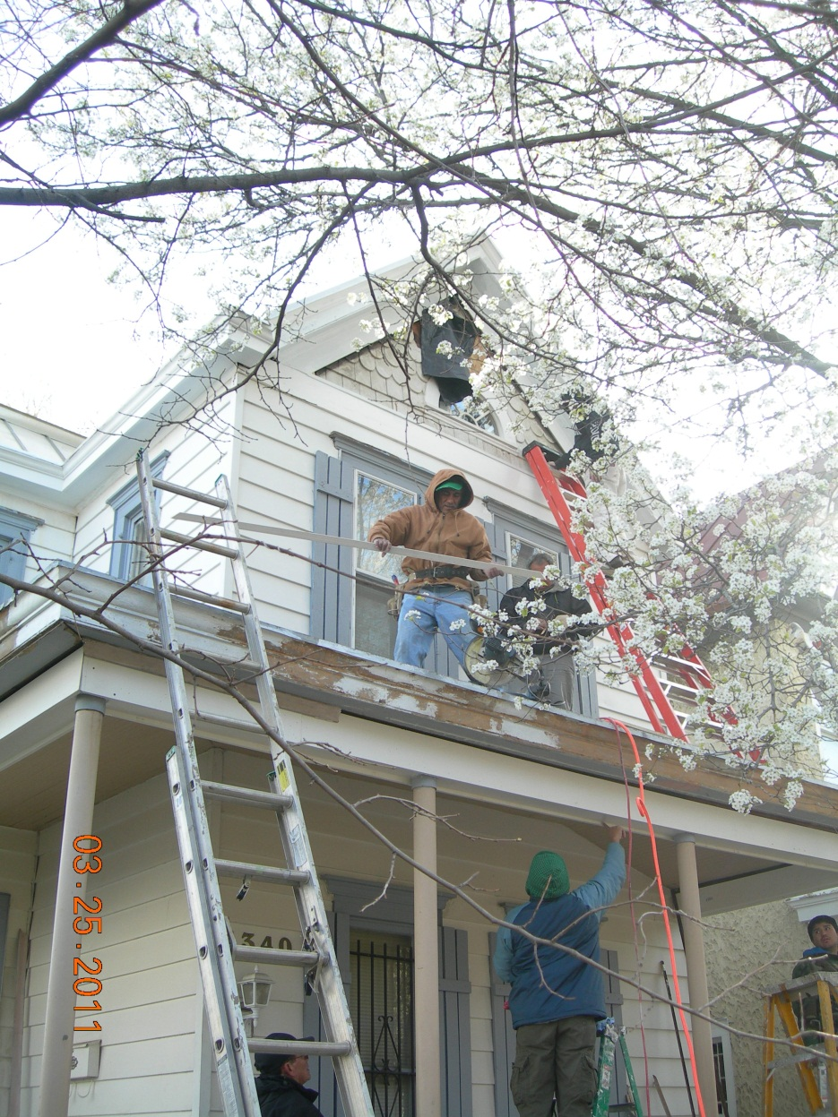
Work Requiring a Permit
Demolition
Subdivisions
New Construction
Alterations
Additions
Repair/replacement of building elements and features

Slide 9
Kinds of Work that Require a Permit
Over-the-Counter Review
Windows
Doors
Retaining Walls
Sheds
Fences
Awnings
Signs
HPRB Review
Demolition
Additions
New Construction
Major alterations and major repairs

Slide 10
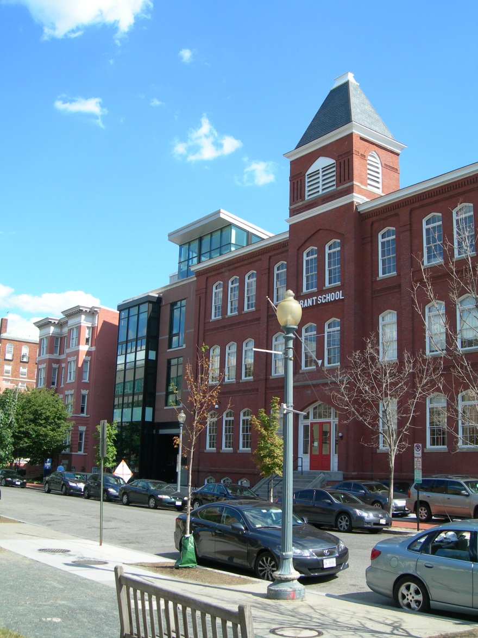
Key Preservation Concept: Compatibility
Possessing characteristics that allow for a harmonious relationship.
Compatibility does not require matching or copying of attributes and may involve the relation of dissimilar things that are juxtaposed to produce an agreeable effect

Slide 11
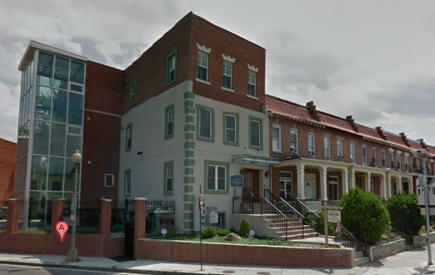
Key Preservation Concept: Incompatibility
Characterized by clashing or conflicting qualities that lead to an incongruous, discordant, or disagreeable relationship
Diversity, variety or contrast does not necessarily imply incompatibility as long as harmonious relationships are maintained.

Slide 12
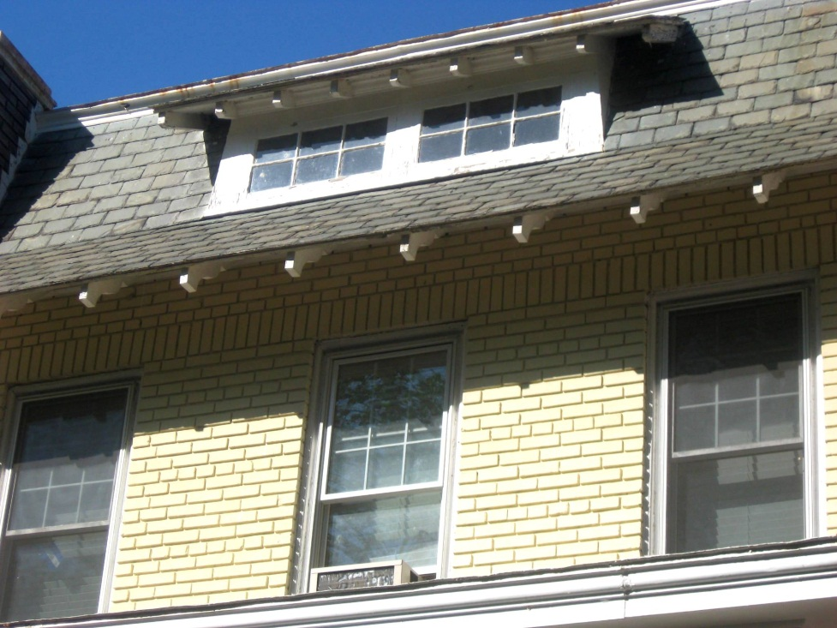
Challenges of Historic Designation
Additional Review at permit stage
Replacement materials may be more expensive
May be seen as contributing to gentrification

Slide 13
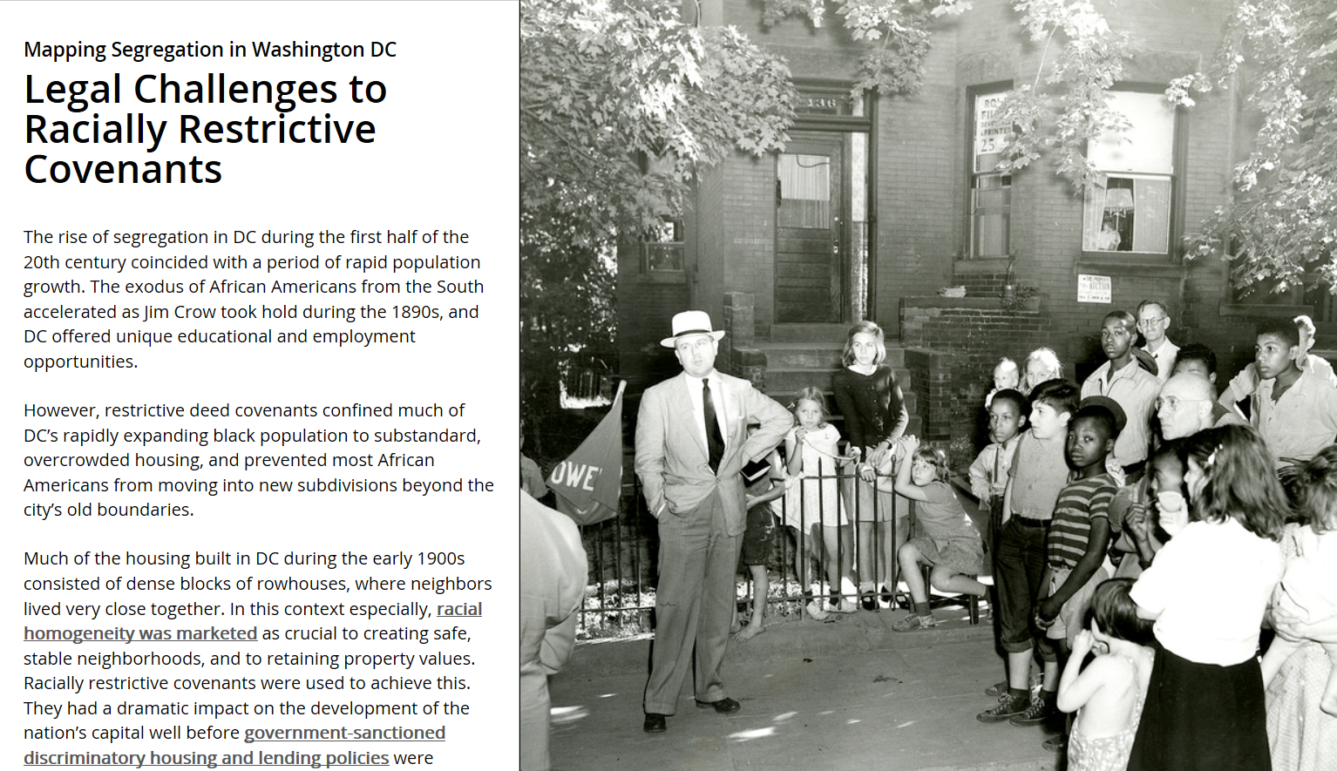
D.C. Designation Criteria
Events: Property is the site of events that contributed significantly to the heritage, culture or development of the District of Columbia or the nation;
History: Property is associated with historical periods, social movements, groups, institutions, achievements, or patterns of growth and change that contributed significantly to the heritage, culture or development of the District of Columbia or the nation;
(C) Individuals: Property is
associated with the lives
of persons significant to
the history of the District
of Columbia or the nation;

Slide 14
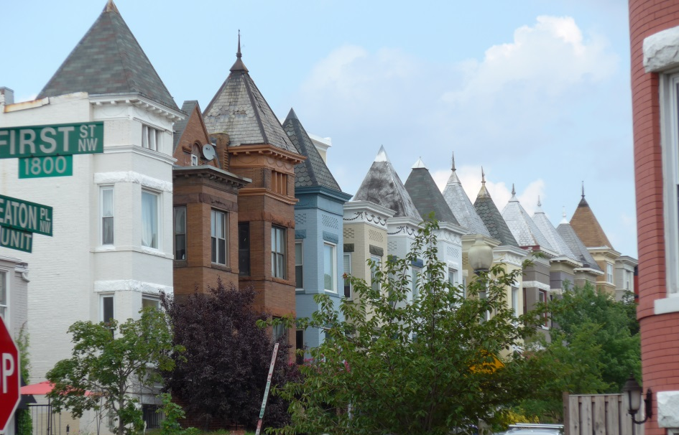
(D) Architecture and Urbanism: Property embodies the distinguishing characteristics of architectural styles, building types, or methods of construction, or are expressions of landscape architecture, engineering, or urban planning, siting, or design;
(E) Artistry: They possess high artistic or aesthetic values that contribute significantly to the heritage and appearance of the District of Columbia or the nation;
Creative Masters: They have been identified as notable works of craftsmen,
artists, sculptors, architects, landscape architects, urban planners, engineers, builders, or developers whose works have influenced the evolution of their fields of endeavor, or are significant to the development of the District of Columbia or the nation; or
(G) Archaeology: They have yielded or may be likely to yield information significant to an understanding of historic or prehistoric events, cultures, and standards of living, building, and design.

